Slide 1
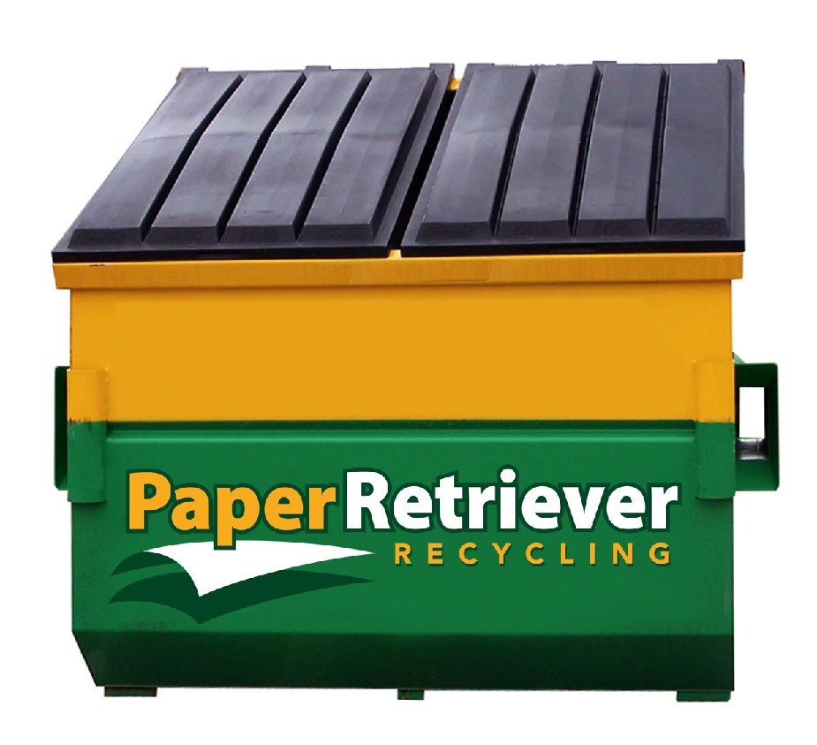
X-Tending Hands, Inc.

Slide 2
History of X-Tending Hands
X-Tending Hands, Inc.
We at X-Tending Hands, Inc. develop new opportunities for homeless persons living with and affected by HIV and AIDS. While responding to their needs and expectations, we provide individuality, dignity, choice, privacy, and a normal, home-like lifestyle. A new outlook on life supports the physical, mental, and emotional well-being of our partners, and enables them to live with self-confidence and respect in their community and throughout their lives. We partner with our clients as they reach their full and utmost potential by ultimately obtaining and maintaining their own homes.

Slide 3
Collaboration with Paper Retriever®
X-Tending Hands, Inc.
X-Tending Hands, Inc. has collaborated with Paper Retriever® for the following reasons:
It benefits the ENVIRONMENT by conserving our natural resources through recycling
It benefits the COMMUNITY by saving tax dollars and reducing the amount of waste sent to the landfill
It helps X-Tending Hands, Inc. raise funds for community projects related to HIV/AIDS awareness and transitional housing services

Slide 4
What Is The Paper Retriever® Program?
X-Tending Hands, Inc.
The program is a simple and free service for communities to use for paper recycling. Distinctive green and yellow Paper Retriever bins are provided to interested parties who encourage the community to bring their paper and put it into a convenient drop off location. Customers are not charged for the bins or the pick-up of paper. In fact, Paper Retriever pays its partners for the paper collected in each bin.

Slide 5
Our Paper Retriever® Location
X-Tending Hands, Inc.
Strayer University Sand Lake Campus
8541 South Park Circle Orlando, FL 32819

Slide 6
What Goes in the Paper Retriever® Bin?
X-Tending Hands, Inc.
Newspaper and Inserts – New newsprint can be made from 100% recycled paper. No virgin fiber has to be added when using this type of process.
Magazines/catalogs – Our Retriever program is happy to take magazines and catalogs, all slick paper. We can use all this high quality/high fiber paper with the exception of any paper coated in wax.
Office/School papers – These types of paper are highly recyclable. Because of the proliferation of paper created by offices and schools, please use the Retriever bin to recycle all that you can. We are able to accept window envelopes, paperback books, workbooks and staples without a problem. Shredded paper is acceptable but please bag the shreds before putting them in the Retriever bin. However, please do not recycle colored paper, wrapping or tissue paper, carbon paper or sticky notes.
Mail – Most direct mail is printed on high quality recyclable paper. Please recycle the mail that you feel comfortable putting in our recycling bin.

Slide 7
Join Paper Retriever®
X-Tending Hands, Inc.
If you would like to place a Paper Retriever® bin in your community or have any questions in regard to this collaboration, please contact:
Barbara Hoosier Executive Director of X-Tending Hands, Inc. 7067 Blair Drive Orlando, FL 32818 (407) 373-0240

Slide 8
For More Information on Paper Retriever®
X-Tending Hands, Inc.
Please visit their website at:
www.PaperRetriever.com

